Slide 1
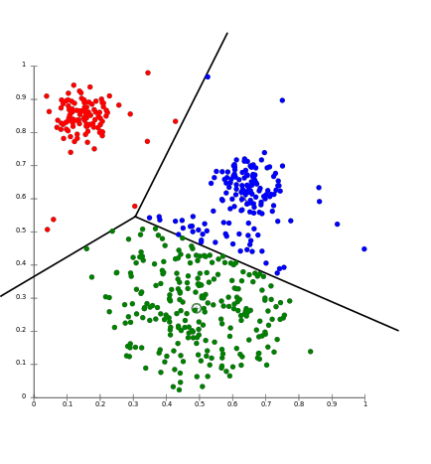
K-means clustering – Project proposal
Marzia Matejcek, Leonie Gerling,
Annika Wehrle, Ege Bayraktar

Slide 2
A few questions
Which algorithm for which type/ size of data?
Limits of several algorithms?
What could we predict if the clustered the data?

Slide 3
Data
gene expression of Peripheral blood mononuclear cells (PBMCs) from a healthy donor
PBMCs = Blood cells with round nucleus, e. g. T-cells, B-cells, Monocytes
2700 cells, 32738 genes (→ dimension reduction, nonlinear)
Methods: UMI (every RNA is marked individually → relation of molecules is conserved)

Slide 4
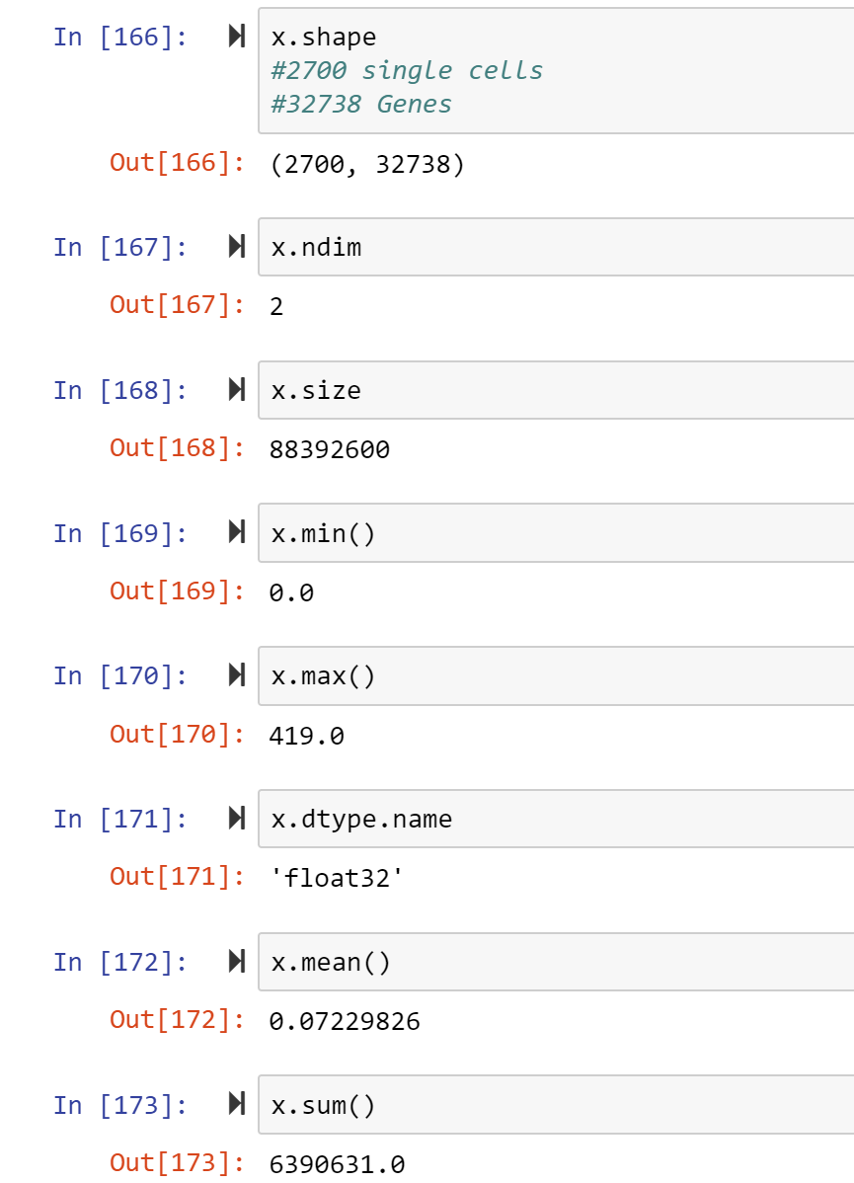
Data exploration
General:
Data = gene expression of Peripheral blood mononuclear cells (PBMCs) from a healthy donor
PBMCs = Blood cells with round nucleus, e. g. T-cells, B-cells, Monocytes
2700 cells, 32738 genes

Slide 5
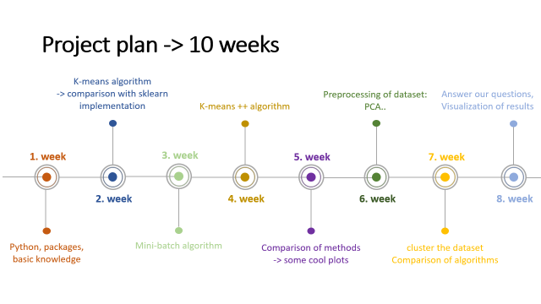
Project plan -> 10 weeks
K-means algorithm
-> comparison with sklearn implementation
1. week
2. week
Python, packages, basic knowledge

Slide 7
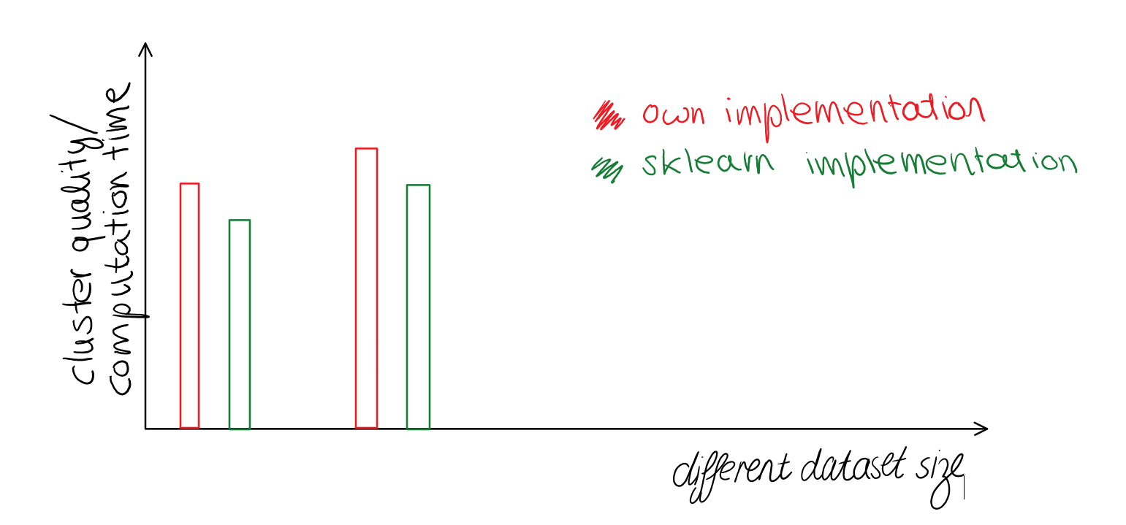
Tabels for different datasets with various sizes:
Multiple plots for visualization:
e.g. :
k | Average sum of squared distance Algorithm sklearn implementation |  | Minimum - “ - |  | Average T (computation time)
i.e. 10
25
50

Slide 8
Project plan -> 10 weeks
K-means algorithm
-> comparison with sklearn implementation
Preprocessing of dataset: PCA..
Answer our questions,
Visualization of results
K-means ++ algorithm
1. week
3. week
5. week
7. week
2. week
4. week
6. week
8. week
Python, packages, basic knowledge
Mini-batch algorithm
Comparison of methods -> some cool plots
cluster the dataset
Comparison of algorithms

